Slide 1

Geography
Journey to the Centre of the Earth
Photo courtesy of (@flickr.com) - granted under creative commons licence - attribution

Slide 2
Lesson Objective
To understand what lies beneath our feet.
Success Criteria
To know the layered structure of the Earth.
To understand what materials are in each layer of the Earth.
To know what happens to the temperature towards the centre of the Earth.

Slide 3
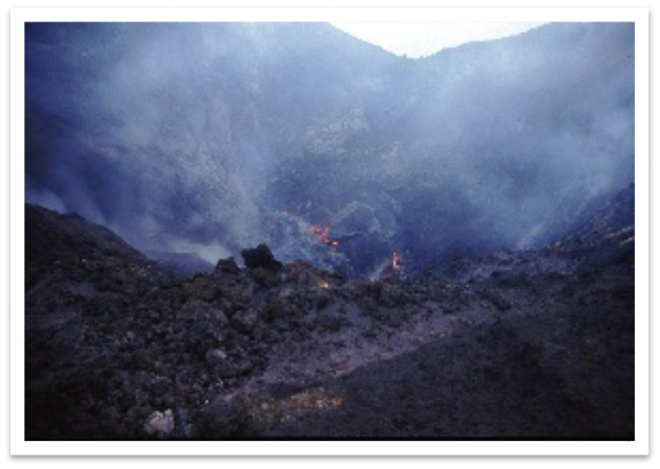

Starter Challenge
The centre of the Earth is 6,370 km away.
How far down have humans been?
Just 2.08km
Photo courtesy of John Charalambous (@flickr.com) - granted under creative commons licence - attribution

Slide 4
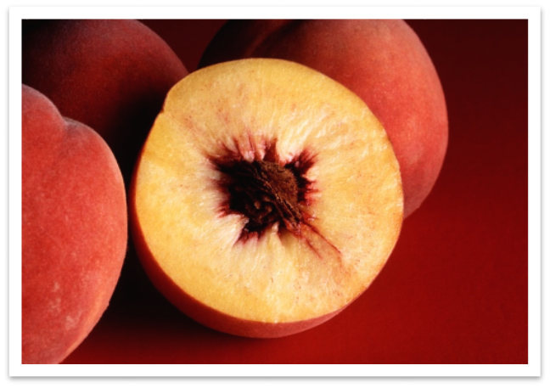
The Structure of Earth
Why do you think the Earth might be like a peach?
It has a skin and the Earth has
a crust
It has a hard centre like the Earth’s core
It has a large fleshy section, like the Earth’s mantle.
Let’s find out more!

Slide 5
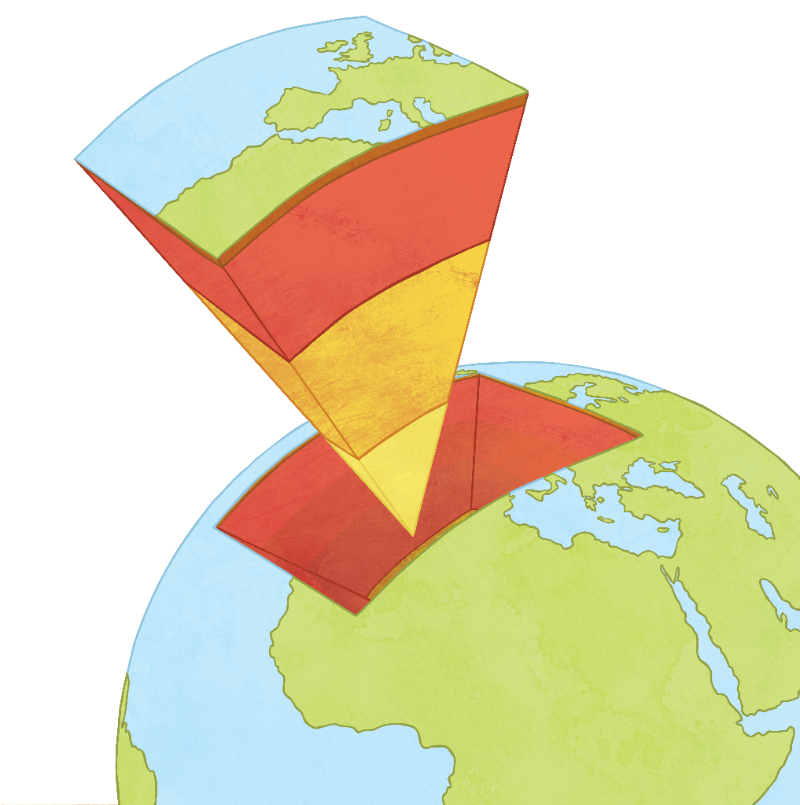
Layers of the Earth
Use the following slides to complete your diagram of the Earth’s structure, adding colours and labels.

Slide 6
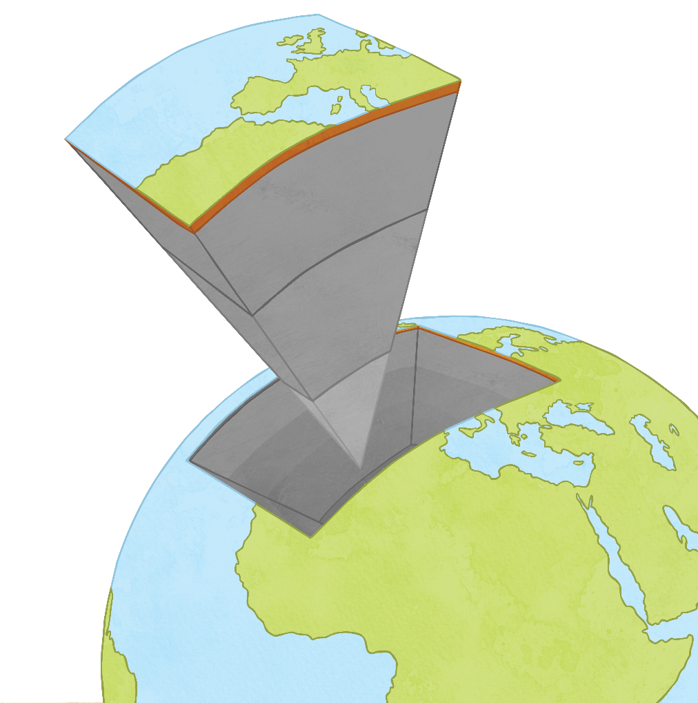
The Crust
Can be split between Continental Crust (beneath the land) and Oceanic Crust (beneath the sea).
On average, it is between 5km and 70km thick.
Temperatures can reach 900°C.
Oceanic crust is made up of basalt.
Continental crust is made up of granite.
Both these rocks are hard, resistant igneous rocks.

Slide 7
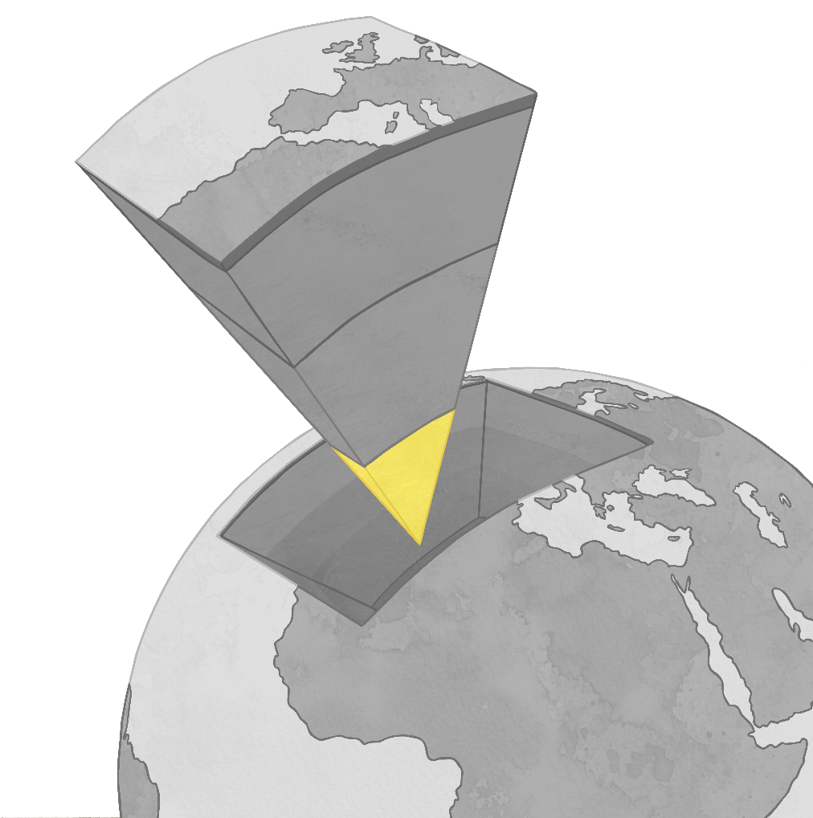
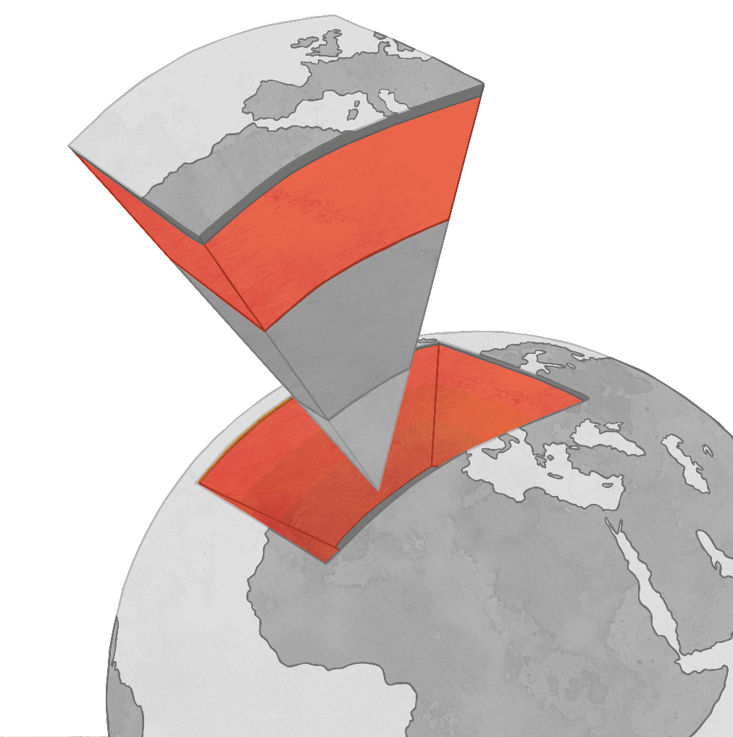
The Mantle
The upper part consists of partially molten rock called magma.
The lower part is made of solid rock.
This is the thickest of the Earth’s layers.
Temperatures at the top are 900°C and reach 4000°C near the bottom of the mantle.
The mantle ends 2900km below the Earth’s surface.

Slide 8
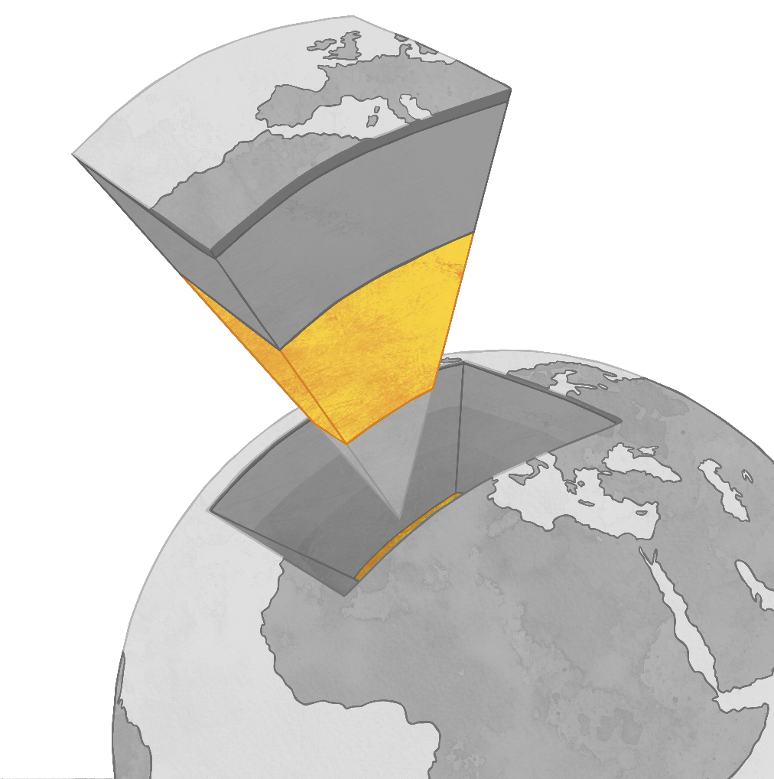
The Outer Core
This is a liquid layer.
It is made up of iron and nickel.
It is the second thickest layer.
Temperatures range from 4000°C to 5000°C.
It is 2266km thick and extends to 5270km below the Earth.

Slide 9
The Inner Core
The centre of the inner core is 6370km from the surface.
The core is a solid ball of iron and nickel.
It has a diameter of 1220km.

Slide 10


Geography Dictionary!
Continental Crust – thick crust with land on it.
Oceanic Crust – thin crust with sea on top.
Lithosphere – the name given to the top sections of the Earth, including the crust and the top of the mantle.
Aesthenosphere - The upper part of the mantle, which is partially molten rock.

Slide 11
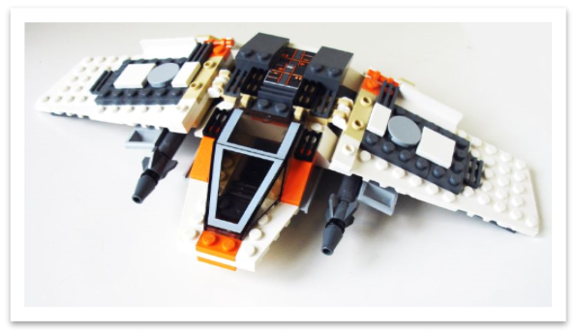
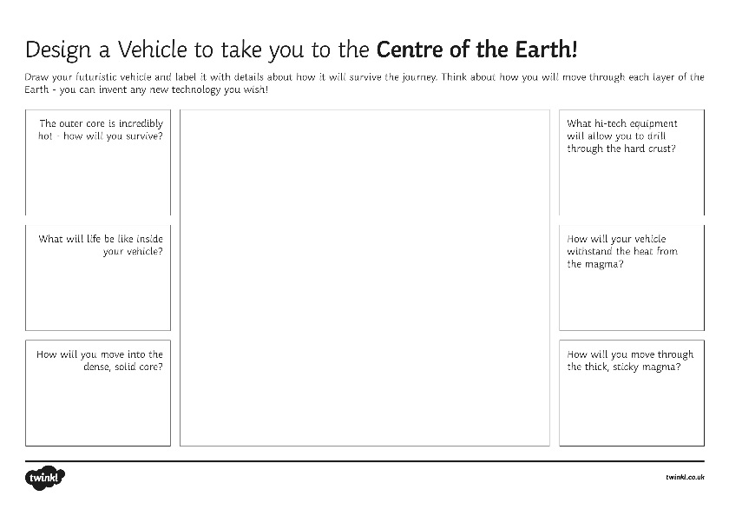
Journey to the Centre of the Earth
Imagine you are going on the first Journey to the Centre of the Earth…
You will need a vehicle that can drill through the crust, survive the hot magma, negotiate liquid metal and pierce the solid iron core.
Let’s design one! You can invent new technology that will get you to
your destination.
Photo courtesy of Ian Muir (@flickr.com) - granted under creative commons licence - attribution

Slide 12
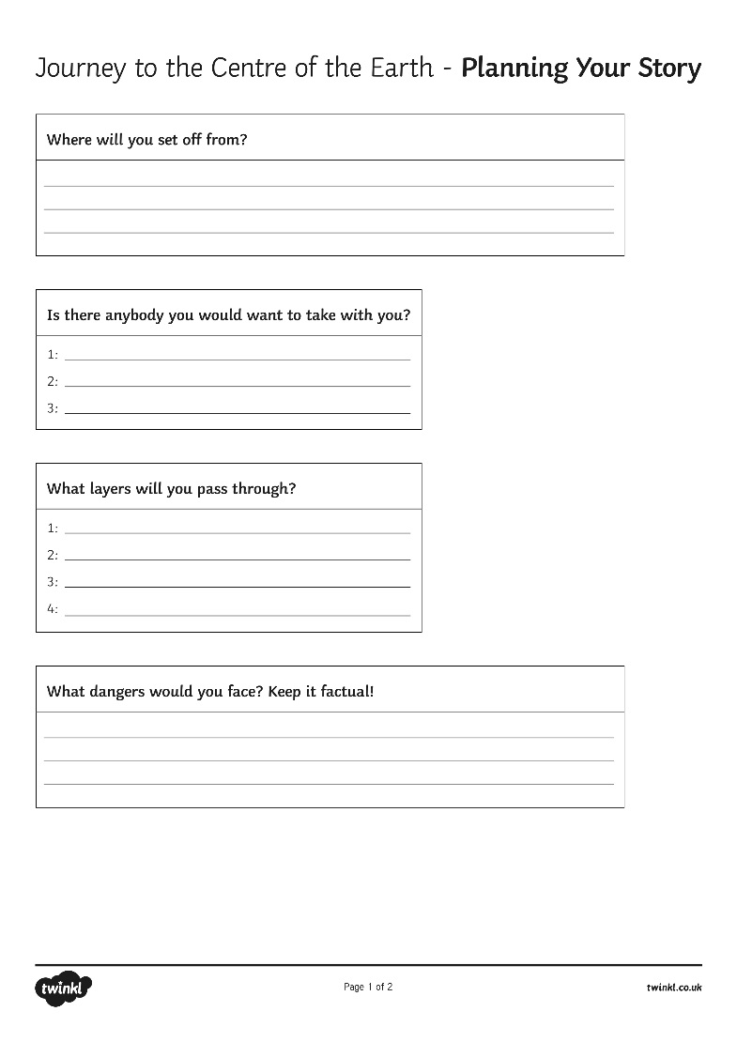
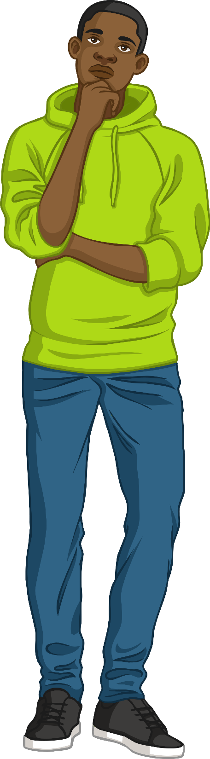
Journey to the Centre of the Earth
Now we’re going to write about our adventure to the centre of the Earth. First we need to carefully plan our story using a story planning sheet…

Slide 13

Journey to the Centre of the Earth
Writing your own Journey to the Centre of the Earth Story.
Use your vehicle design and story plan to help you.
Describe what happens as you enter the Earth’s crust.
Add tension as you head through the hot mantle.
Describe the sight of liquid iron and nickel at the outer core.
What can you hear/see/smell as you pierce through the inner core?
Include lots of detail, such as what the layers are made of, what temperature they are and how deep they are
Include at least five powerful adjectives.
Good luck!

Slide 14

Peer marking checklist
Let your partner mark your work
Checklist
Have they:
Mentioned the journey through
the crust?
Described what the mantle is like?
Given details about the outer and inner core?
Said what each layer is made of?
Given figures about the temperature?
Explained about the depth of
each layer?
Included at least five adjectives?
Give your partner two stars and one wish.
Be VERY specific about what they need to do to improve.

Slide 15
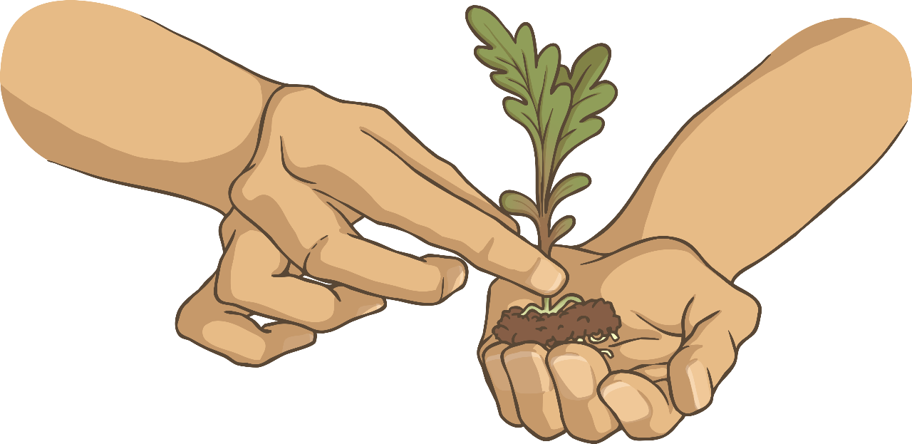
Grow Your Work!
Spend time acting on the “Wish” given to you by your partner. Go back and make your work more detailed, adding more description if necessary.

Slide 16

Fill in the gaps!
The outer rock layer of the Earth is called the
CRUST

Slide 17
Fill in the gaps!
The partially molten layer of the Earth is called the upper
MANTLE

Slide 18
Fill in the gaps!
The Earth’s core consists of
IRON
NICKEL
and

Slide 19
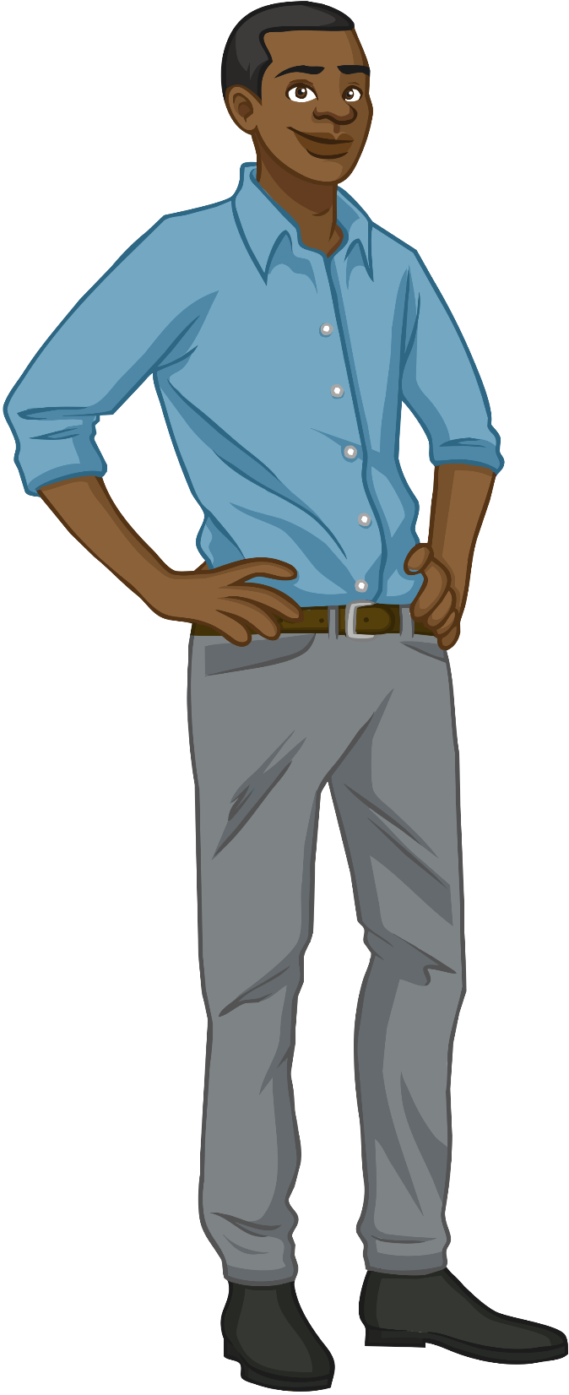
Discussion!
Do you think humans will ever travel to the centre of
the Earth?

